Slide 1
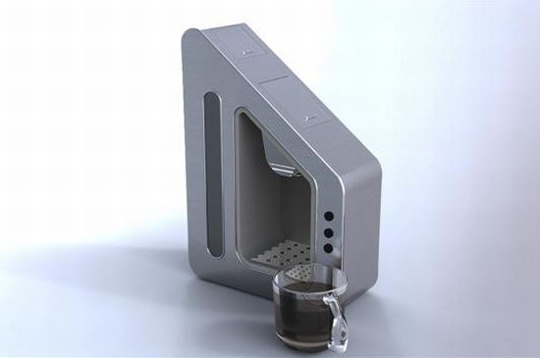
Coffee Maker for Hand Tremors:
Design #2 - Voice Integration & Thermal Insulation
Jake Shultz & Joshua Feinberg
EDD 104 - Section 55

Slide 2
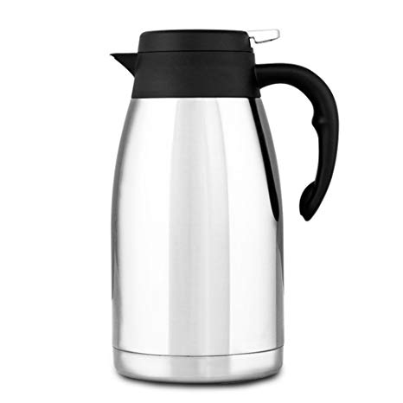
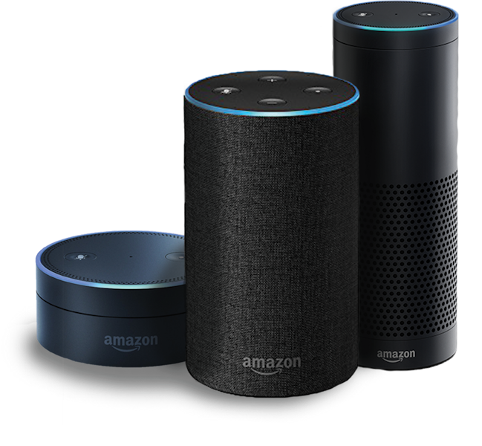
Agenda
Design Statement
Description of Alternative Design
Advantages and Disadvantages
Pahl and Beitz Matrix
Conclusion

Slide 3
Design Statement:
“Design a coffee maker for persons with hand tremors that is ergonomically safe and easy to use.”

Slide 4
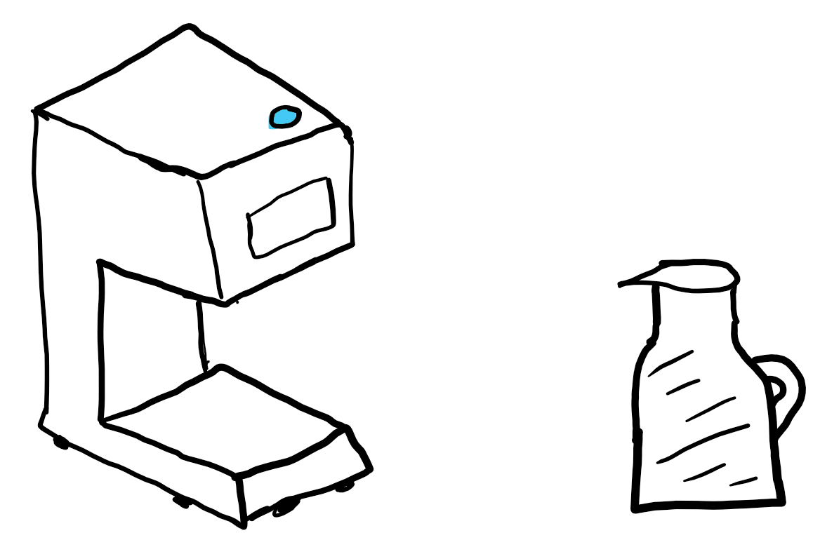
Solutions
Voice Integration of an external API
Amazon Alexa, Google Home, Apple Homepod
Thermal Insulation of Device
Double-Walled Vacuum Insulation
Self-Heating Carafe
Rubber Stabilization of Base
High Coefficient of Friction - 𝝁

Slide 5
Description of Voice Integration
Bridge between the smart device and the coffee maker
Amazon’s Alexa will be the example, but all APIs are generally used the same way
Amazon makes an ACK (Alexa Connect Kit) specifically for these cases
Circuit Board placed in the device, and it communicates with the nearby Alexa
No need for coding or, or managing cloud data!

Slide 6
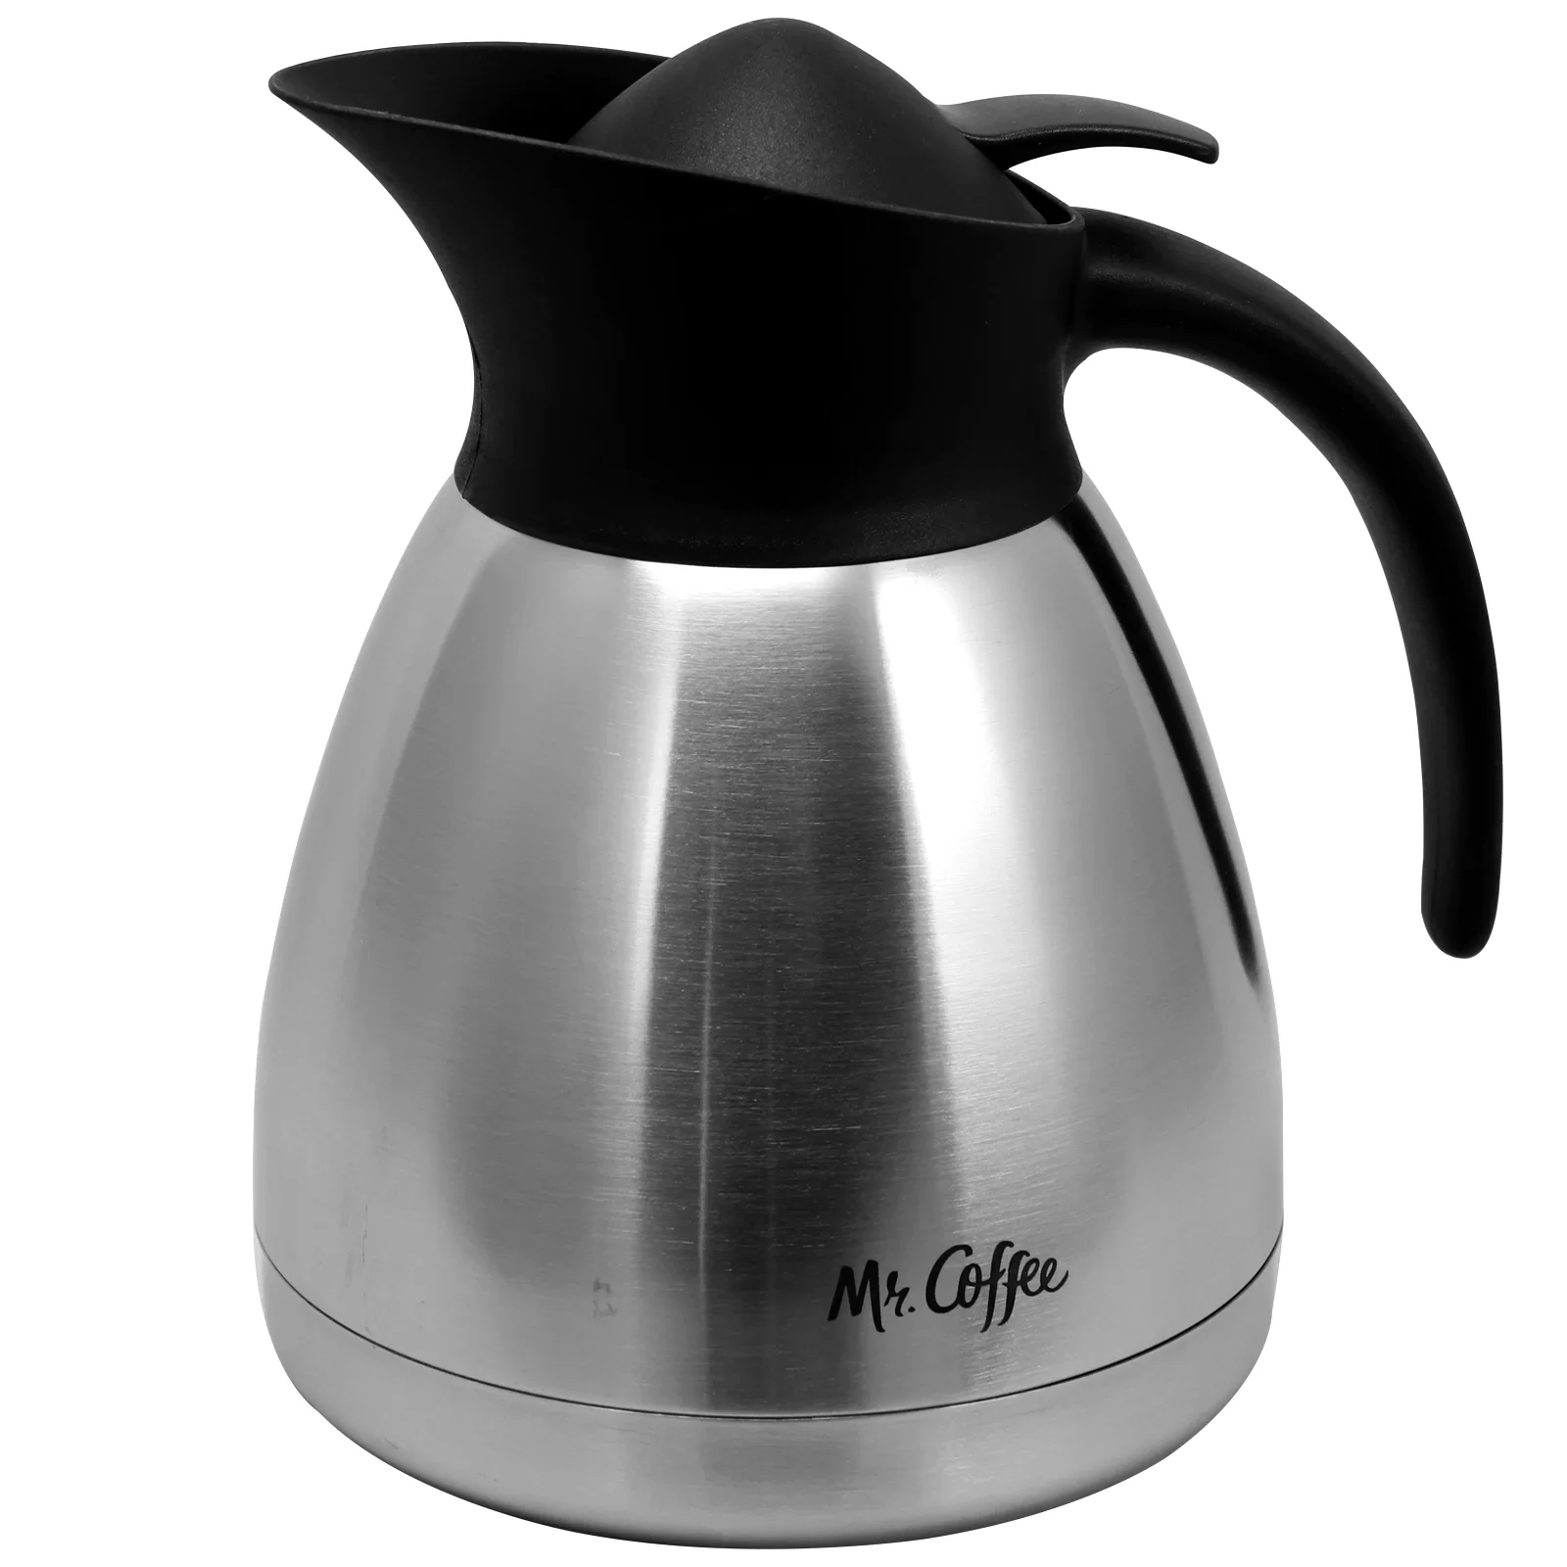
Description of Double-Walled Vacuum Insulation
Carafe features a double wall design with a completely empty space between the walls
The space between the walls is devoid of air
This eliminates all possibility of heat transfer to the outside
There are almost no particles to carry heat from inner wall to outer wall

Slide 7
Description of the Self-Heating Carafe
Heating components will run along the inside vacuum space
The heating components will connect to a microcontroller (Arduino, Raspberry Pi, etc.)
The microcontroller will connect to:
Rechargeable Battery (supplies power)
Temperature sensor
LED Screen
Buttons and indicator lights around LED screen

Slide 8
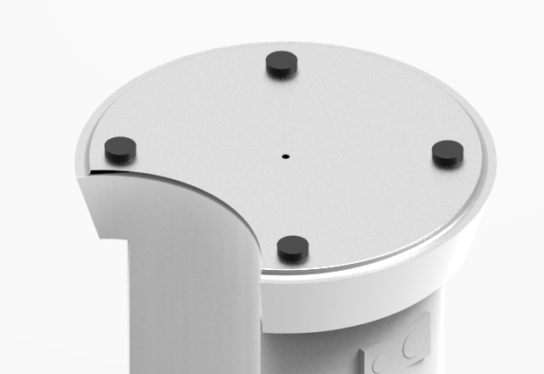

Description of Rubber Stabilization
Rubber standoffs located on the bottom of the device provide maximum coefficient of static and kinetic friction
Takes much more force to move the device, preventing accidents when tremors occur

Slide 9
First-Tier Requirements
[CMT 1.1] The device shall be usable by people with hand tremors.
Logical Argument - Little to no physical interaction
[CMT 1.2] The device shall be capable of brewing 2 to 6 cups of coffee at once.
Capacity of the filter, with duration of the drip controlled via voice commands

Slide 10
First Tier Requirements (continued)
[CMT 1.3] The device shall use standard coffee filters with coffee grounds.
Drawing and measurements of the capacity of the grind compartment
[CMT 1.4] The device shall fit on a standard kitchen counter-top.
CAD - realistic measurements of the coffee maker will be displayed on Solid Edge

Slide 11
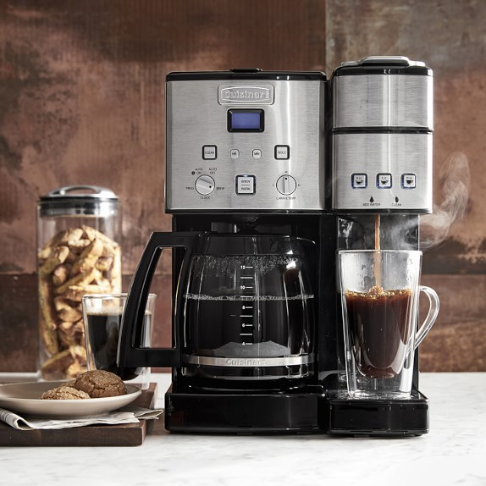
First Tier Requirements (continued #2)
[CMT 1.5] The design should consider the entire coffee making process.
From voice control to thermal regulation, our design focuses on all aspects of the coffee making process - making it easy as possible for all users

Slide 12
Pahl and Beitz Criteria
Structure
User Interaction
Safety
Maintenance
Performance
Cost

Slide 13
Structure
[STRC 2.1] The device shall weigh no more than 10 pounds. {CMT 1.1}
Density and amount of material provides weight of the coffee maker
[STRC 2.2] The user shall not have to reach across the machine to load water into the device. {CMT 1.1}
The water reservoir is located in the front of the device

Slide 14
Structure (continued)
[STRC 2.3] The device shall hold a maximum of 50 fluid ounces of water in the reservoir. {CMT 1.2}
This can also be verified via a solid edge structure - the volume capacity of the reservoir can be easily calculated.
[STRC 2.4] The device shall be able to hold a filter with a minimum of 60 grams of coffee grounds {CMT 1.5}
Logical Argument - since the average coffee filter holds enough coffee for 8 to 12 cups and the average cup has 7 grams of coffee

Slide 15

Structure (continued #2)
[STRC 2.5] The device shall be compatible with multiple types of standard coffee filters. {CMT 1.3}
CAD - Solid Edge can show that the size of the filter input will fit standard coffee filters

Slide 16

User Interaction
[UIN 2.1] The user shall be able to select the amount of coffee to brew within 5 minutes. {CMT 1.1}
A simple voice command can control how much coffee is brewed, all under the 5 minute ceiling

Slide 17
Safety
[SAFE 2.1] The device shall have a tolerance up to 4.5cm to prevent spilling. {CMT 1.1}
The extra lip on top of the carafe (above the fill line) prevents this
[SAFE 2.2] The device shall have no exposed heating elements that will reach a temperature of 111 degrees Fahrenheit. {CMT 1.1}
CAD - the materials used in Solid Edge and the design used for the carafe will have no option for exposed heating elements

Slide 18
Safety (continued)
[SAFE 2.3] The device shall turn off after being idle for 2 hours. {CMT 1.1}
This can be accomplished with the Amazon Alexa integration as one of Alexa’s voice command settings
[SAFE 2.4] The device shall have an auto-shutoff feature if temperature reaches above 250 degrees. {CMT 1.1}
This will be programmed into the microcontroller in the carafe and will integrated into the Amazon Alexa command settings

Slide 19

Safety (continued #2)
[SAFE 2.5] The device shall not have more than 12 BARs of pressure. {CMT 1.1}
Logical Argument - Most coffee maker pumps go up to 9 BARs of pressure and 9 BARs of pressure is used to make espresso, a high-pressure brewed coffee

Slide 20
Maintenance
[MTN 2.1] The device shall be able to be cleaned within 30 minutes. {CMT 1.1}
CAD - Solid Edge can show the easy disassembly and few parts that need to be cleaned
[MTN 2.2] The device shall be able to be set up within 15 minutes by someone with hand tremors. {CMT 1.1}
Logical Argument - the device will come set up, the user will only need to remove wrapping and attach carafe to begin brewing

Slide 21
Performance
[PFR 2.1] The coffee shall be brewed within 15 minutes. { CMT 1.5}
Logical Argument - average coffee makers brew 12 cups of coffee within 8-12 minutes, well under the 15 minute requirement
[PFR 2.2] The coffee shall be brewed at no more than 210° Fahrenheit. {CMT 1.2}
The heating components in the coffee maker will be connected to the Amazon Alexa ACK and will allow the user to control the temperature

Slide 22
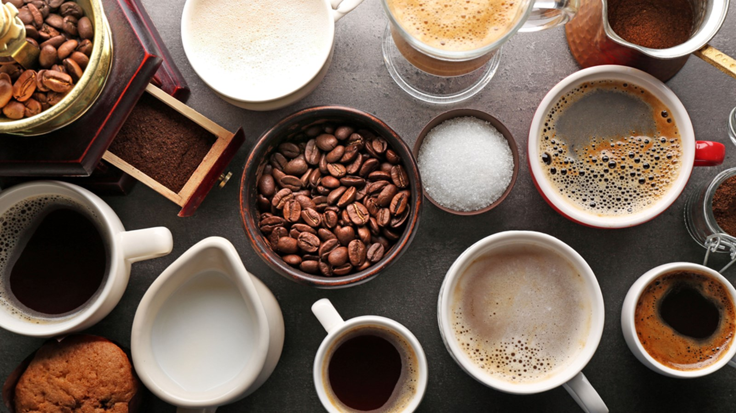
Performance (continued)
[PFR 2.3] The device shall alert the user when the coffee has finished brewing. {CMT 1.5}
CAD - The Solid Edge design will show an LED indicator on the carafe that will light when the coffee finishes brewing

Slide 23
Cost
Amazon’s ACK is a one time purchase, granting access to Alexa’s API for all built devices from that point forward
Cheaper alternative than paying a subscription fee for the host of a server for processing
The thermal insulation can be cost effective, as producing the heat to maintain the coffee’s temperature costs much more in terms of electricity.

Slide 24
Conclusion
Key Features
Voice Integration via API Software
Thermal Insulation of Device & Thermal Regulation of Carafe
Advantages
Limited physical interaction needed
Sturdy base to prevent accidents
Disadvantages
May be above average in cost
Need Smart Home Device to take advantage of design

Slide 25
References (Josh)
Alsaif, Hussain F. (2017). Emerging Technologies; Materials: Genetics to Structures; Safety Engineering and Risk Analysis, 15, 14. doi: 10.1115/IMECE2017-70588
Atlas Steels Technical Department (2013). Stainless Steel Grade Data Sheets [Data Set]. Retrieved from http://www.worldstainless.org/Files/issf/non-image-files/PDF/Atlas_Grade_datasheet_-_all_datasheets_rev_Aug_2013.pdf
Lohner, S. (2017, January 5). Stay Warm with Thermal Insulation. Retrieved from https://www.scientificamerican.com/article/stay-warm-with-thermal-insulation/
Wong, A. (2016, September 21). What's the difference between 18/0, 18/8, and 18/10 flatware? Retrieved from https://www.linkedin.com/pulse/whats-difference-between-180-188-1810-flatware-alice-wong

Slide 26
References (Jake)
Alexa for Smart Home Devices. (n.d.). Retrieved from
https://developer.amazon.com/alexa/devices/smart-home-devices
Create a smart home Action | Actions on Google | Google Developers. (n.d.). Retrieved from
https://developers.google.com/actions/smarthome/create
EDD 103 Engineering Team #3 - Jake Shultz, Eric Tremsky, Matt Cutolo, Michael Esquivel
Iced Tea Maker Render & Building
Palasantzas, G. (2005). Comparison of hysteric and adhesive coefficient of friction for rubbers
sliding onto self-affine rough surfaces. Journal of Applied Physics,97(3), 034906.
doi:10.1063/1.1844617
Python Tutorial- Build Python Projects with Alexa. (n.d.). Retrieved from
https://developer.amazon.com/alexa-skills-kit/alexa-skill-python-tutorial

